Slide 1
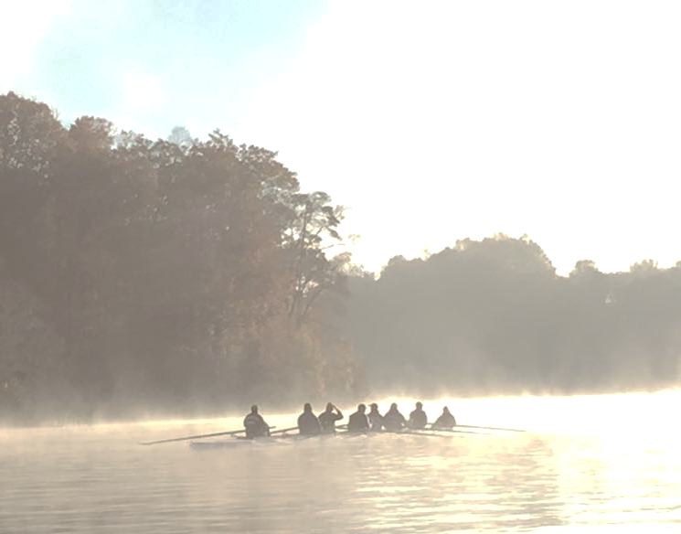
PWRC General Membership Meeting
2024

Slide 2
Agenda
2024 Board & Support (Kerrie)
Objectives (Kerrie)
Programs (Kerrie)
Coaching (Kerrie & Coaches)
Code of Conduct (Kerrie)
Communication (Chris)
Important Dates (Bruce)
Budget (Dorothy)
Registration (Dorothy)
Equipment (Dorothy)
Regatta Fees (Dorothy)
Regattas (Renee’)
Health & Safety (Kerrie)
Social (Debbie)
Wrap-Up (Kerrie)

Slide 3
Leadership (Kerrie)
Kerrie Golden – President, Coaches
Bruce Ware – Vice President & Non-Board Duties
Dorothy Sorensen – Treasurer, Regatta Fees & Boat Leasing
Kerri Pagel – Secretary
Miller Kehlet – Spirit Wear/Uniforms & Social Coordinator
Renee Johnson – Regatta & Coxswain Coordinator, Coaches
2024 Board
Judy Powell – Learn to Row & Adult Novice Camp
Robert Allen – Equipment Maintenance
Debbie Ware – Social Coordinator
Denyse Carroll - Social Cmte & Team Captains
Melissa Rife - Surveys

Slide 4
Support (Kerrie)
Supporting Personnel
Sue Hearney – Website
Chris Page - Social Media and Marketing
Volunteers Needed!*
Equipment/Maintenance – Team Reps
2024 Social Committee
Learn-To-Row Days
Novice Camp
Rock the Occ Half Marathon
Boathouse Workdays
POC for launch engine gas
Hang flyers for LTR & Camps
And more throughout the season!
Look for the Volunteer Sign-Up in your email

Slide 5
2024 Objectives (Kerrie)
Promoting a vision of a community club
Partnership with PWCA
Continue partnership Lake Ridge Park
Promote inclusivity
Engage in community service projects
Continue to enhance club efficiency
Promote use of iCrew and better utilize all its tools
Early selection of team captains to enhance communication
Contribute your ideas!
Ongoing recruitment and membership growth
Both rowers & coxswains
Enhance access to all rowing options
Sculling camps
Include sculling introduction into novice season
Encourage regatta participation

Slide 6
2024 Programs (Kerrie)
Novice
The goal of the Novice Program is to introduce new members to the sport of rowing. By reinforcing the fundamentals of technique, fitness, and sportsmanship, rowers will progress from learning how to handle an oar to competing in fall races.
Intermediate Sweep
The Intermediate Sweep Program will be focused on a combination of a higher development of rowing technique and aerobic exercise. Although racing is not the primary goal of the Intermediate Team, it does allow for some racing opportunities throughout the summer and fall rowing seasons.
Sculling
The Sculling Program is for individuals with sculling experience who may compete in both sprint and head races. Rowers will row in quads, doubles and singles.

Slide 7
2024 Programs (Kerrie)
Racing Teams (Men and Women)
The goal of the Racing Programs (Men and Women) is to be a highly competitive Master’s rowing program. The Racing Programs provide a competitive environment that encourages personal growth, commitment, and teamwork in both mastery of the rowing stroke technique and the being physically ready to compete. Members build and improve upon the successes of the previous year and aim to compete at the highest level at home and away regattas for both summer sprint and fall head race seasons with the goal of successfully competing in high level races such as the Head of the Charles. Individuals may compete in multiple races in the same regatta and opportunities for racing in Mixed lineups are available.

Slide 8
2024 Programs (Kerrie)
Expanded Rowing Season
All teams will row T/Th/Sat thru the end of Sep
Sat/Sun rowing starting 1 Oct until end of season
Spring rowing - optional for all experienced teams
Learn to Row Workshops –
Three free workshops to help bring rowing to our community (7 and 21 April and 5 May)

Slide 9
2024 Programs Cont (Kerrie)
Adult Novice Camp
Two-week camp for adult novices (21 May thru 1 June)
Season Start/Boat Inspection - 1 June
Sculling Camps
Two camps (M/W/F) with 12 sessions in each camp for beginning scullers
July: 1-19 July
August: 5-23 Aug
Rock the Occ Half Marathon – 7 September 2024

Slide 10
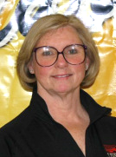
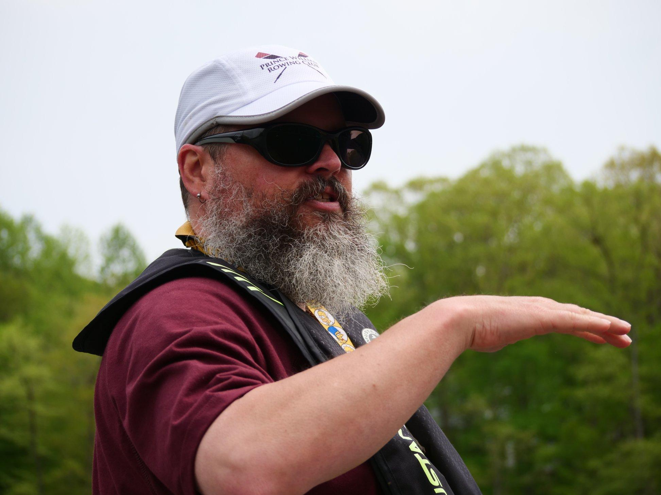
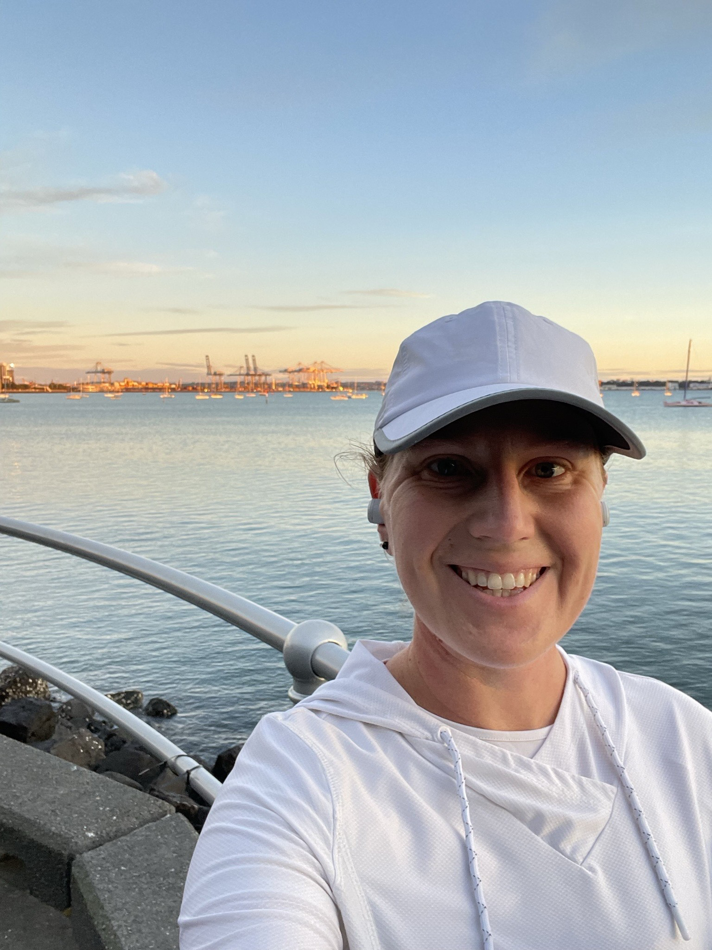
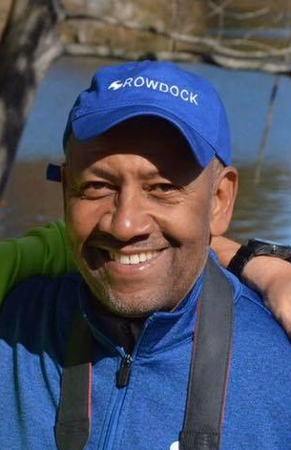
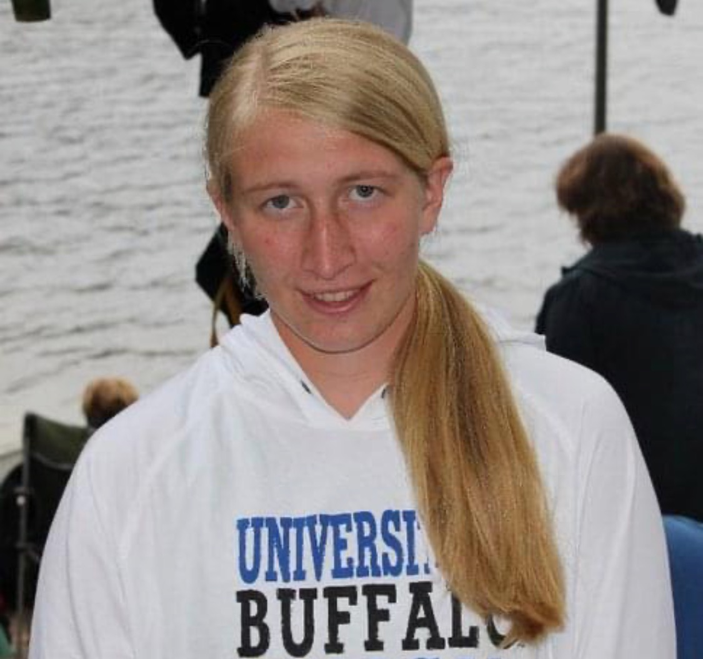
Coaches (Judy)
Racing Men Jason Compy
Racing Sculling Miller Kehlet
Novice
Racing Men
Jeanette Nicewinter
Racing Women
Melissa Ward
Intermediate
Al Wilson

Slide 11
Code of Conduct (Kerrie)
Reminder to read and adhere to the
PWRC Code of Conduct
“All rowers, coaches, coxswains will be
treated with respect.”
Respect and listen to your coaches and coxswains
Coaches determine seats and lineups based on many different factors
Rowers are on the water to row, improve their skills and work as a team

Slide 12
Communication (Chris)
Methods of Communication
Weekly President’s Message
iCrew emails for routine communication along with texts for urgent (e.g. weather cancellation) communications
web page: www.pwrc.org
Email: info@pwrc.org
Team Captains: relay information to/from coaches and Board
Find us on Social Media:
Twitter - @PW_Rowing_Club
Facebook - Prince William Rowing Club
Instagram - prince_william_rowing

Slide 13
Marketing (Chris)
Learn to Row & Novice Camp
Introduction to our program
Flyers available, downloadable from the website, images can be shared from social media.
Members and coaches are encouraged to post flyers
Those involved with local HS teams – speak to your crew parents about PWRC; many of our rowers were crew parents first.
Share Facebook events with your friends
Invite a friend!
Our strongest marketing is from our members.
Wear your PWRC gear

Slide 14
2024 Calendar – Important Spring Dates
April 7 (Sun) – Learn To Row #1, 1-3 PM
April 21 (Sun) – Learn To Row #2, 1-3 PM
May 5 (Sun) – Learn To Row #3, 1-3 PM
May 21 - Jun 1 (T/Th/Sat) – Adult Novice Camp
April/May (Sundays) – spring sessions
June 1 (Sat) – First day of season
See the Google Calendar on the web page for all dates

Slide 15
Budget Highlights (Dorothy)
Season Dues
$740 Racing Men/Racing Women/Intermediate/Sculling
Everyone going until the end of September, NO ONE except HOCR boats gets extra fall weekday rows
Preseason rowing charged per session using punch card option
$715 Novice
$690 for Novice Camp Graduates*
$75 Associate member
Sculling camps
Non-PWRC Member $225/first session
USRowing waiver administrative processing fee
Rower’s basic membership fee ($20) is covered by PWRC
PWRC Member $175/session*
Novice Camp - $150
*Novice camp grads and PWRC members will get discount codes in order to get those prices

Slide 16
Dues and Don’ts
Dues Include:
65 coached practice sessions
3x/week June-September, weekends only October-November
Coach and cox stipends
Shell and launch rental fees
USRowing membership
PWCA boathouse and dock user and Port-a-Potty fees
Gas
Equipment and Maintenance (cox boxes, cleaning supplies, repairs)
Administrative (bank, insurance, registration, office) fees
Don’t Include:
Regatta Fees
Preseason Rows
Spirit Wear or Uniforms
Payment Transaction Fees

Slide 17
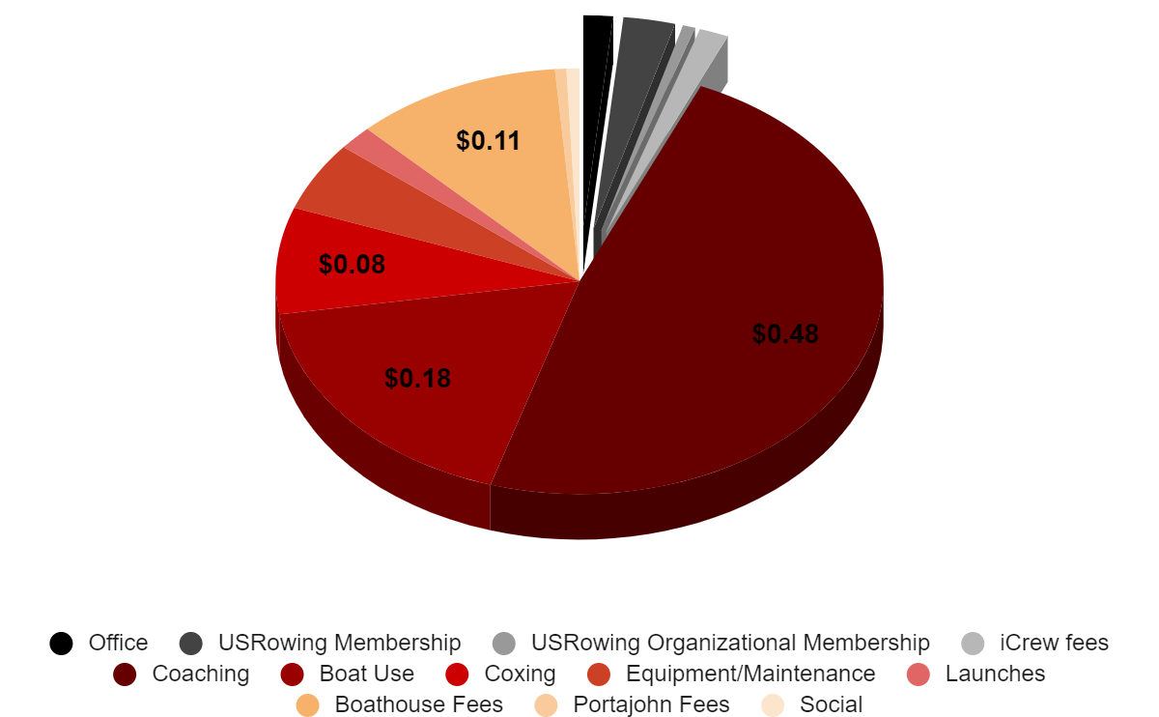
Where do my dues go?

Slide 18
Registration (Dorothy)
Registration requirements
Club registration through iCrew
USRowing waiver completed online with USRowing
You must be registered in order to participate in the Spring Preseason Rows
Your regatta account cannot be in arrears
Registration/payment through iCrew
HIGHLY recommend downloading the iCrew app
QR Codes for registration and app downloads at the end of the slideshow
Registration link posted on website soon

Slide 19
Registration (Dorothy)
Payment Options
Pay in full
Payment plan (3 payments): First of the month for 3 months starting at registration
Payment for regattas can be put on a plan as requested
Pay electronically only
Debit or credit card (has higher transaction fees)
ACH/bank transfer (has lower transaction fees)
USRowing Membership
Must be a member of USRowing to row with PWRC
Basic Membership ($25 for new & $20 for current members paid by PWRC)
Championship Membership ($65 paid by rower)
Championship membership is required to compete in USRowing events in Championship categories

Slide 20
Registration (Dorothy)
USRowing Waiver and SafeSport
During registration in iCrew the rower will see a link in the documents to fill out the online waiver
Waiver is good for 12 months from date of completion
Renee will upload USRowing compliance
Complete SafeSport attestation in USRowing account and complete SafeSport training - accessed via USRowing
Additional Requirements
Verify you’ve watched the USRowing safety video
Sign the PWRC Code of Conduct and Lake Ridge Marina Rules
Approve use of photos from PWRC practices,
events, and regattas

Slide 21
Equipment (Dorothy)
Shell Leases
Rent shells and launches from the high school teams
Why don’t we own our own boats? No room in the boathouse for more shells, no storage space when we’re out of season, and we’re not full members in the boathouse
Recapitalization projects
Refurbished old oars (new handles for Racing Women, new blade wraps for Racing Men)
Purchased new oars
Upgraded coxboxes
Put together coxswain bags with tools for practices

Slide 22
Regatta Fees (Dorothy)
Regatta fees are separate from club registration fees
Regattas are billed individually through iCrew
Each rower can see their individual regattas with notes regarding their participation
No lump sum payment option
No deposits before participation either
Regatta fees cover:
Registration fees; trailering costs; coach per diem, parking, and tolls
Racing teams usually race more and both on and off the Occoquan and therefore have more and higher fees ($300-$500)
Intermediate and Novice teams usually stay on the Occoquan and have fewer and lower fees ($50-$100)

Slide 23
Regattas (Renee’)
Two-week deadlines for lineup submissions
•Facilitates assignment of shells for races
•Allows time to arrange for equipment and trailer rentals
•Allows crews to practice their lineup for the races
Suggest that team representatives help organize carpooling to away events
Away regattas are for racing team rowers, unless the Board approves intermediate and novice rowers to attend
At least one PWRC coach at each regatta - could be one coach for multiple teams if agreed upon ahead of time.

Slide 24
Regattas
DATE | SUMMER EVENTS | TYPE | LOCATION
Sun, 8 JUNE | Stonewall Regatta | Sprint | Washington, DC
Sat, 15 JUNE | VBC Sprints Masters Regatta | Sprint | Midlothian, VA
Sat/Sun: 22/23 JUNE | Diamond State Masters Regatta | Sprint | Middletown, DE
Sat, 6 JULY | Robert E Day Jr Capital Sprints | Sprint | Washington, DC
Sat, 7 JULY | Occoquan Memorial Sprints | Sprint | Fairfax Station, VA
Sun, 6 AUGUST | Beak of the Chick | Sprint | Williamsburg, VA
Sat, AUGUST | Quaker City Regatta | Sprint | Philadelphia, PA

Slide 25
Regattas
DATE | FALL EVENTS | TYPE | LOCATION
Sat, 7 SEP | Rock the Occ! Half Marathon | 13.1mi Race | Woodbridge, VA
Sun, 24 SEP | Head of the Chick | Head Race | Williamsburg, VA
Sun, SEP | Head of the Potomac | Head Race | Washington, DC
Sun, 8 OCT | Occoquan Challenge | Head Race | Fairfax Station, VA
Sun, 15 OCT | Occoquan Chase | Head Race | Fairfax Station, VA
Sat/Sun: 21/22 OCT | 58th Head of the Charles | Head Race | Cambridge, MA
Sun, 22 OCT | Head of the Lafayette | Head Race | Norfolk, VA
Sat, 29 OCT | Head of the Schuylkill | Head Race | Philadelphia, PA
Sat/Sun, 2/3 NOV | Head of the Occoquan | Head Race | Fairfax Station, VA

Slide 26
Health and Safety
DO NOT come to the boathouse if you are sick but DO contact your coach
DO NOT return to rowing until symptoms are resolved (e.g. fever free for 24-hours without medication)
DO NOT row hurt. If you have an injury, notify your coach, seek appropriate medical care, if needed, and return when cleared or symptom free.
DO bring a reusable water bottle with plenty of water. We row in the summer so it’s hot. Dehydration and heat injuries are a real risk
DO dress for the weather - wear layers in cold/cool weather. . DO NOT wear cotton

Slide 27
Social (Miller/Debbie)
We have fun on and off the water!
Pre-Season Meeting and Social
End of Season Meeting and Party
Boathouse Breakfasts - each team hosts
Thirsty Thursdays at Water’s End Brewery
Regular after practice
Themed - chili cook-off, dog days, ice cream social
Other Fun Stuff in the Works
Movies
Axe Throwing
Paddle Board
Winery
Mini-Golf

Slide 28
Wrap Up (Kerrie)
Winter Workouts!
zoomergos.com
darkhorserowing.com
other online options
QUESTIONS?

Slide 29
Questions?

Slide 30
Back-Up Slides

Slide 31
PWCA Updates
Who is PWCA?
Prince William Crew Association
Maintains the boathouse & docks
Manages all scholastic rowing in Prince William County.
PWRC is an associate member.
Boathouse Improvements
Oar Savers
Junior summer rowing programs
Novice
Experienced developmental and sculling
Competitive summer and fall teams
Expanding rowing in Prince William County

Slide 32
QR Registration Codes
Register now on iCrew!
The large QR code to the right will take you to the registration link, where you can begin the process to create an iCrew profile and register with PWRC for the 2024 season. The link will be posted on the website soon.
The codes below will take you to the app stores to download the free iCrew app compatible with your phone.
Apple iOS
Android

Slide 33
Sponsors
Thank you to
our AMAZING
sponsors!!

